Slide 1
Stupidoc
Report: 吴秋祺, 姚星河, 陈林尧, 张舒昱

Slide 2
Table of Contents
Front-End
Database
Back-End

Slide 3
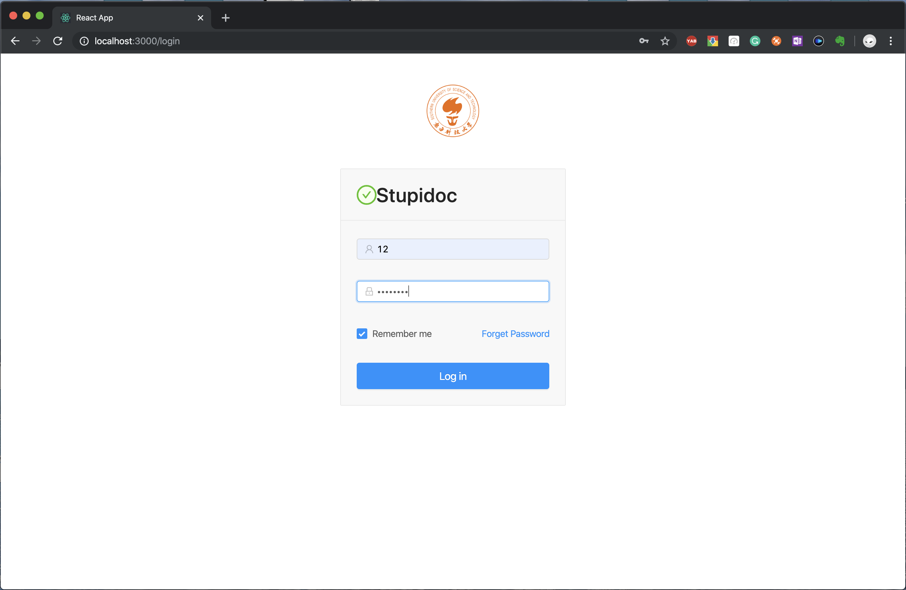
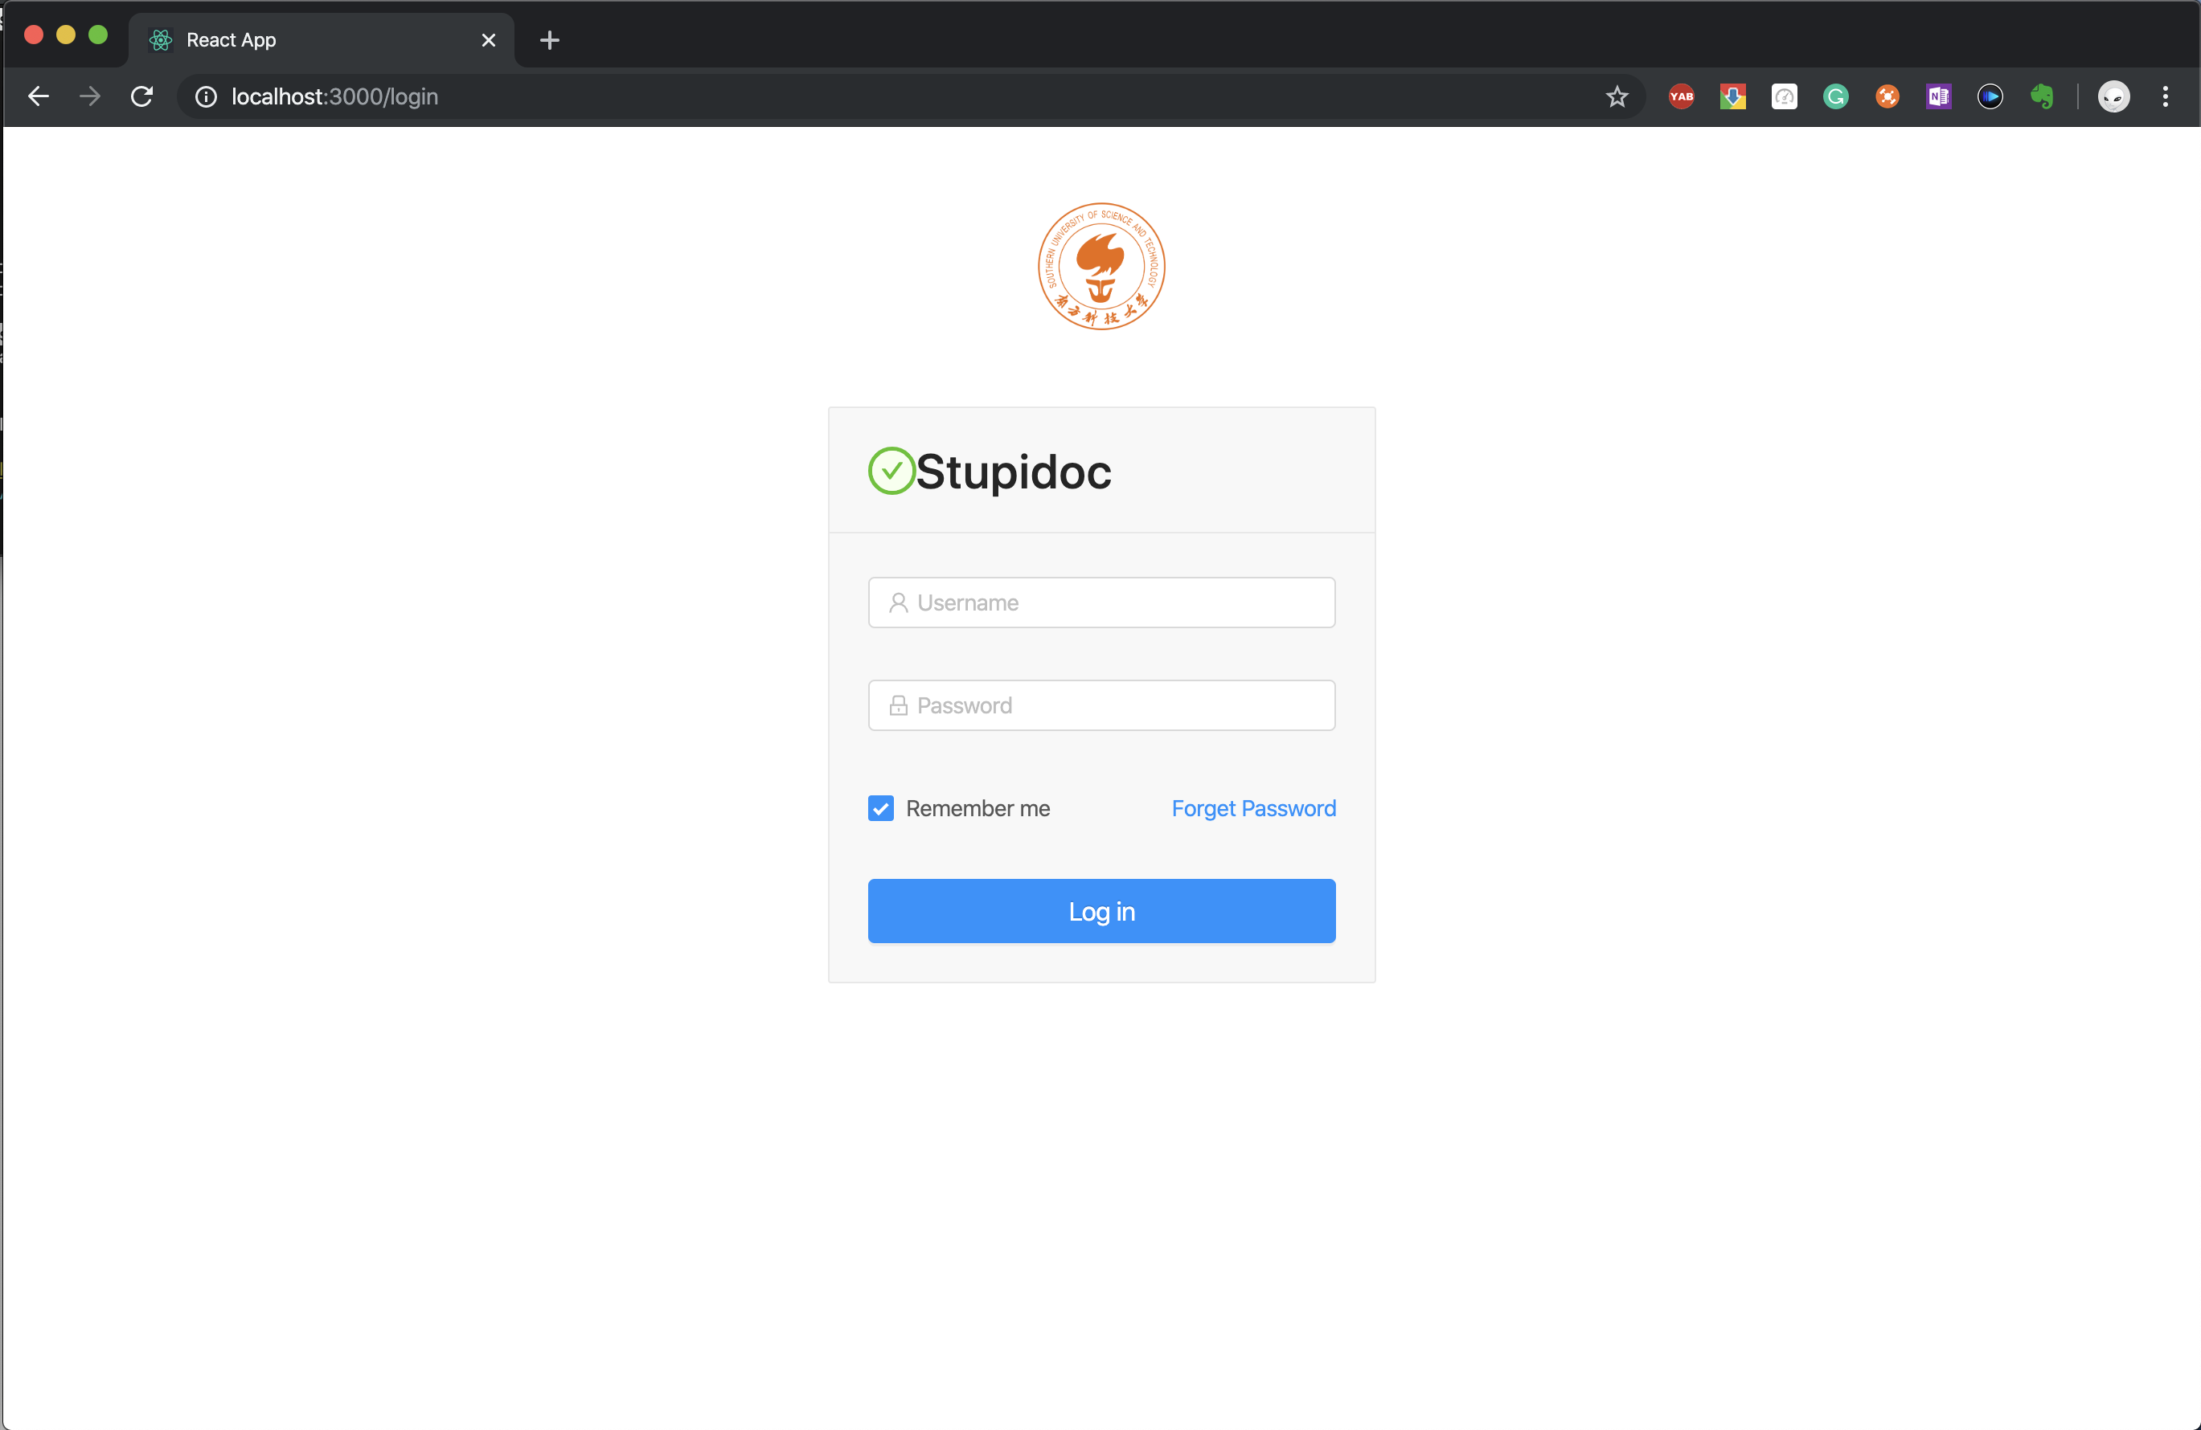
Front-End : Login Page
- ☑️Remember Password - ☑️Login

Slide 4
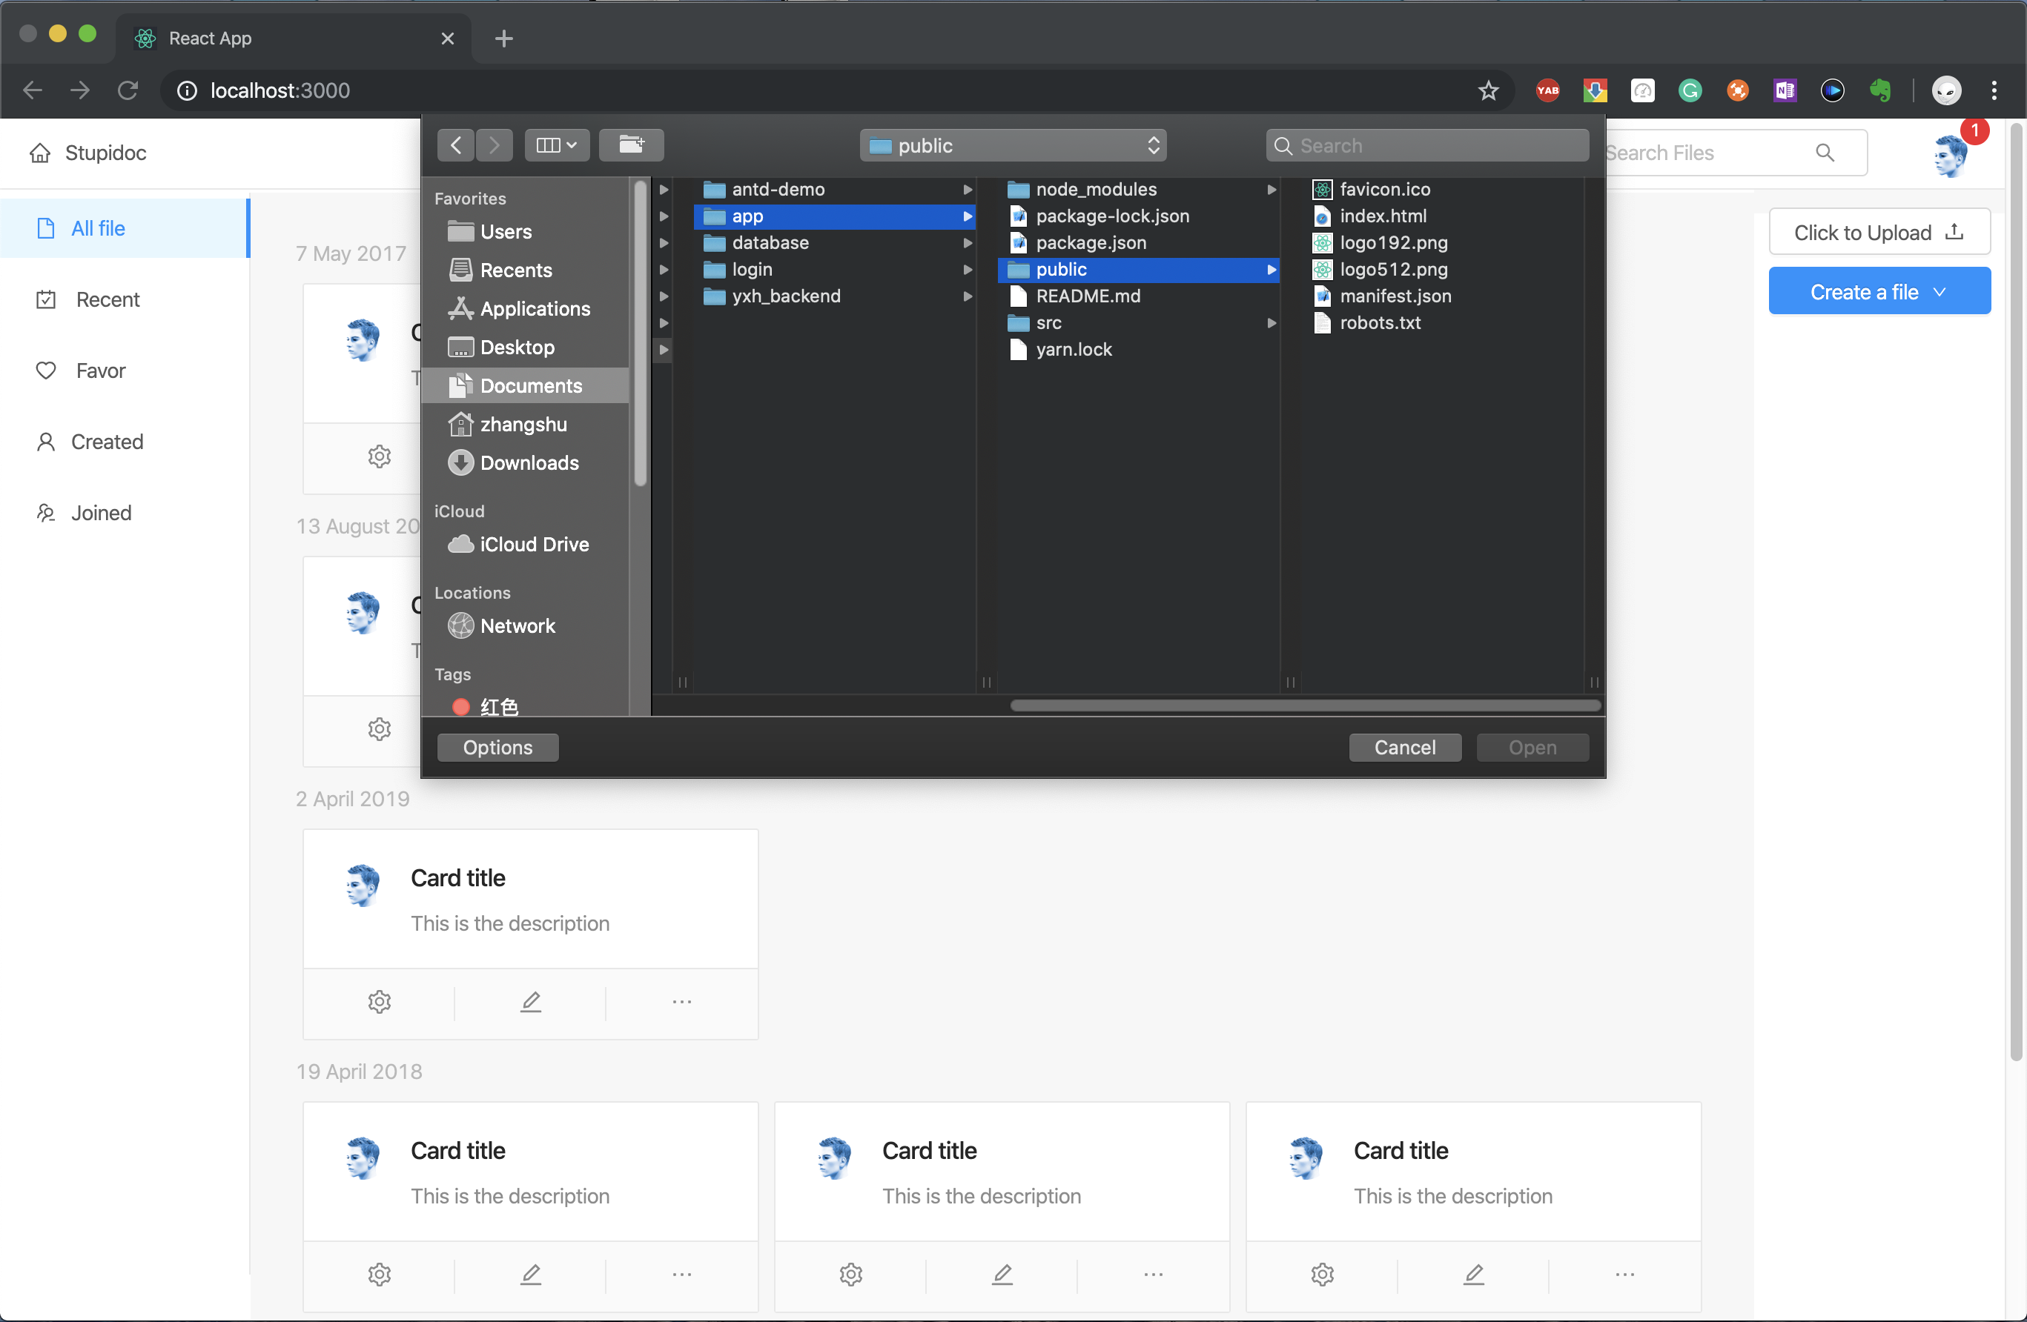
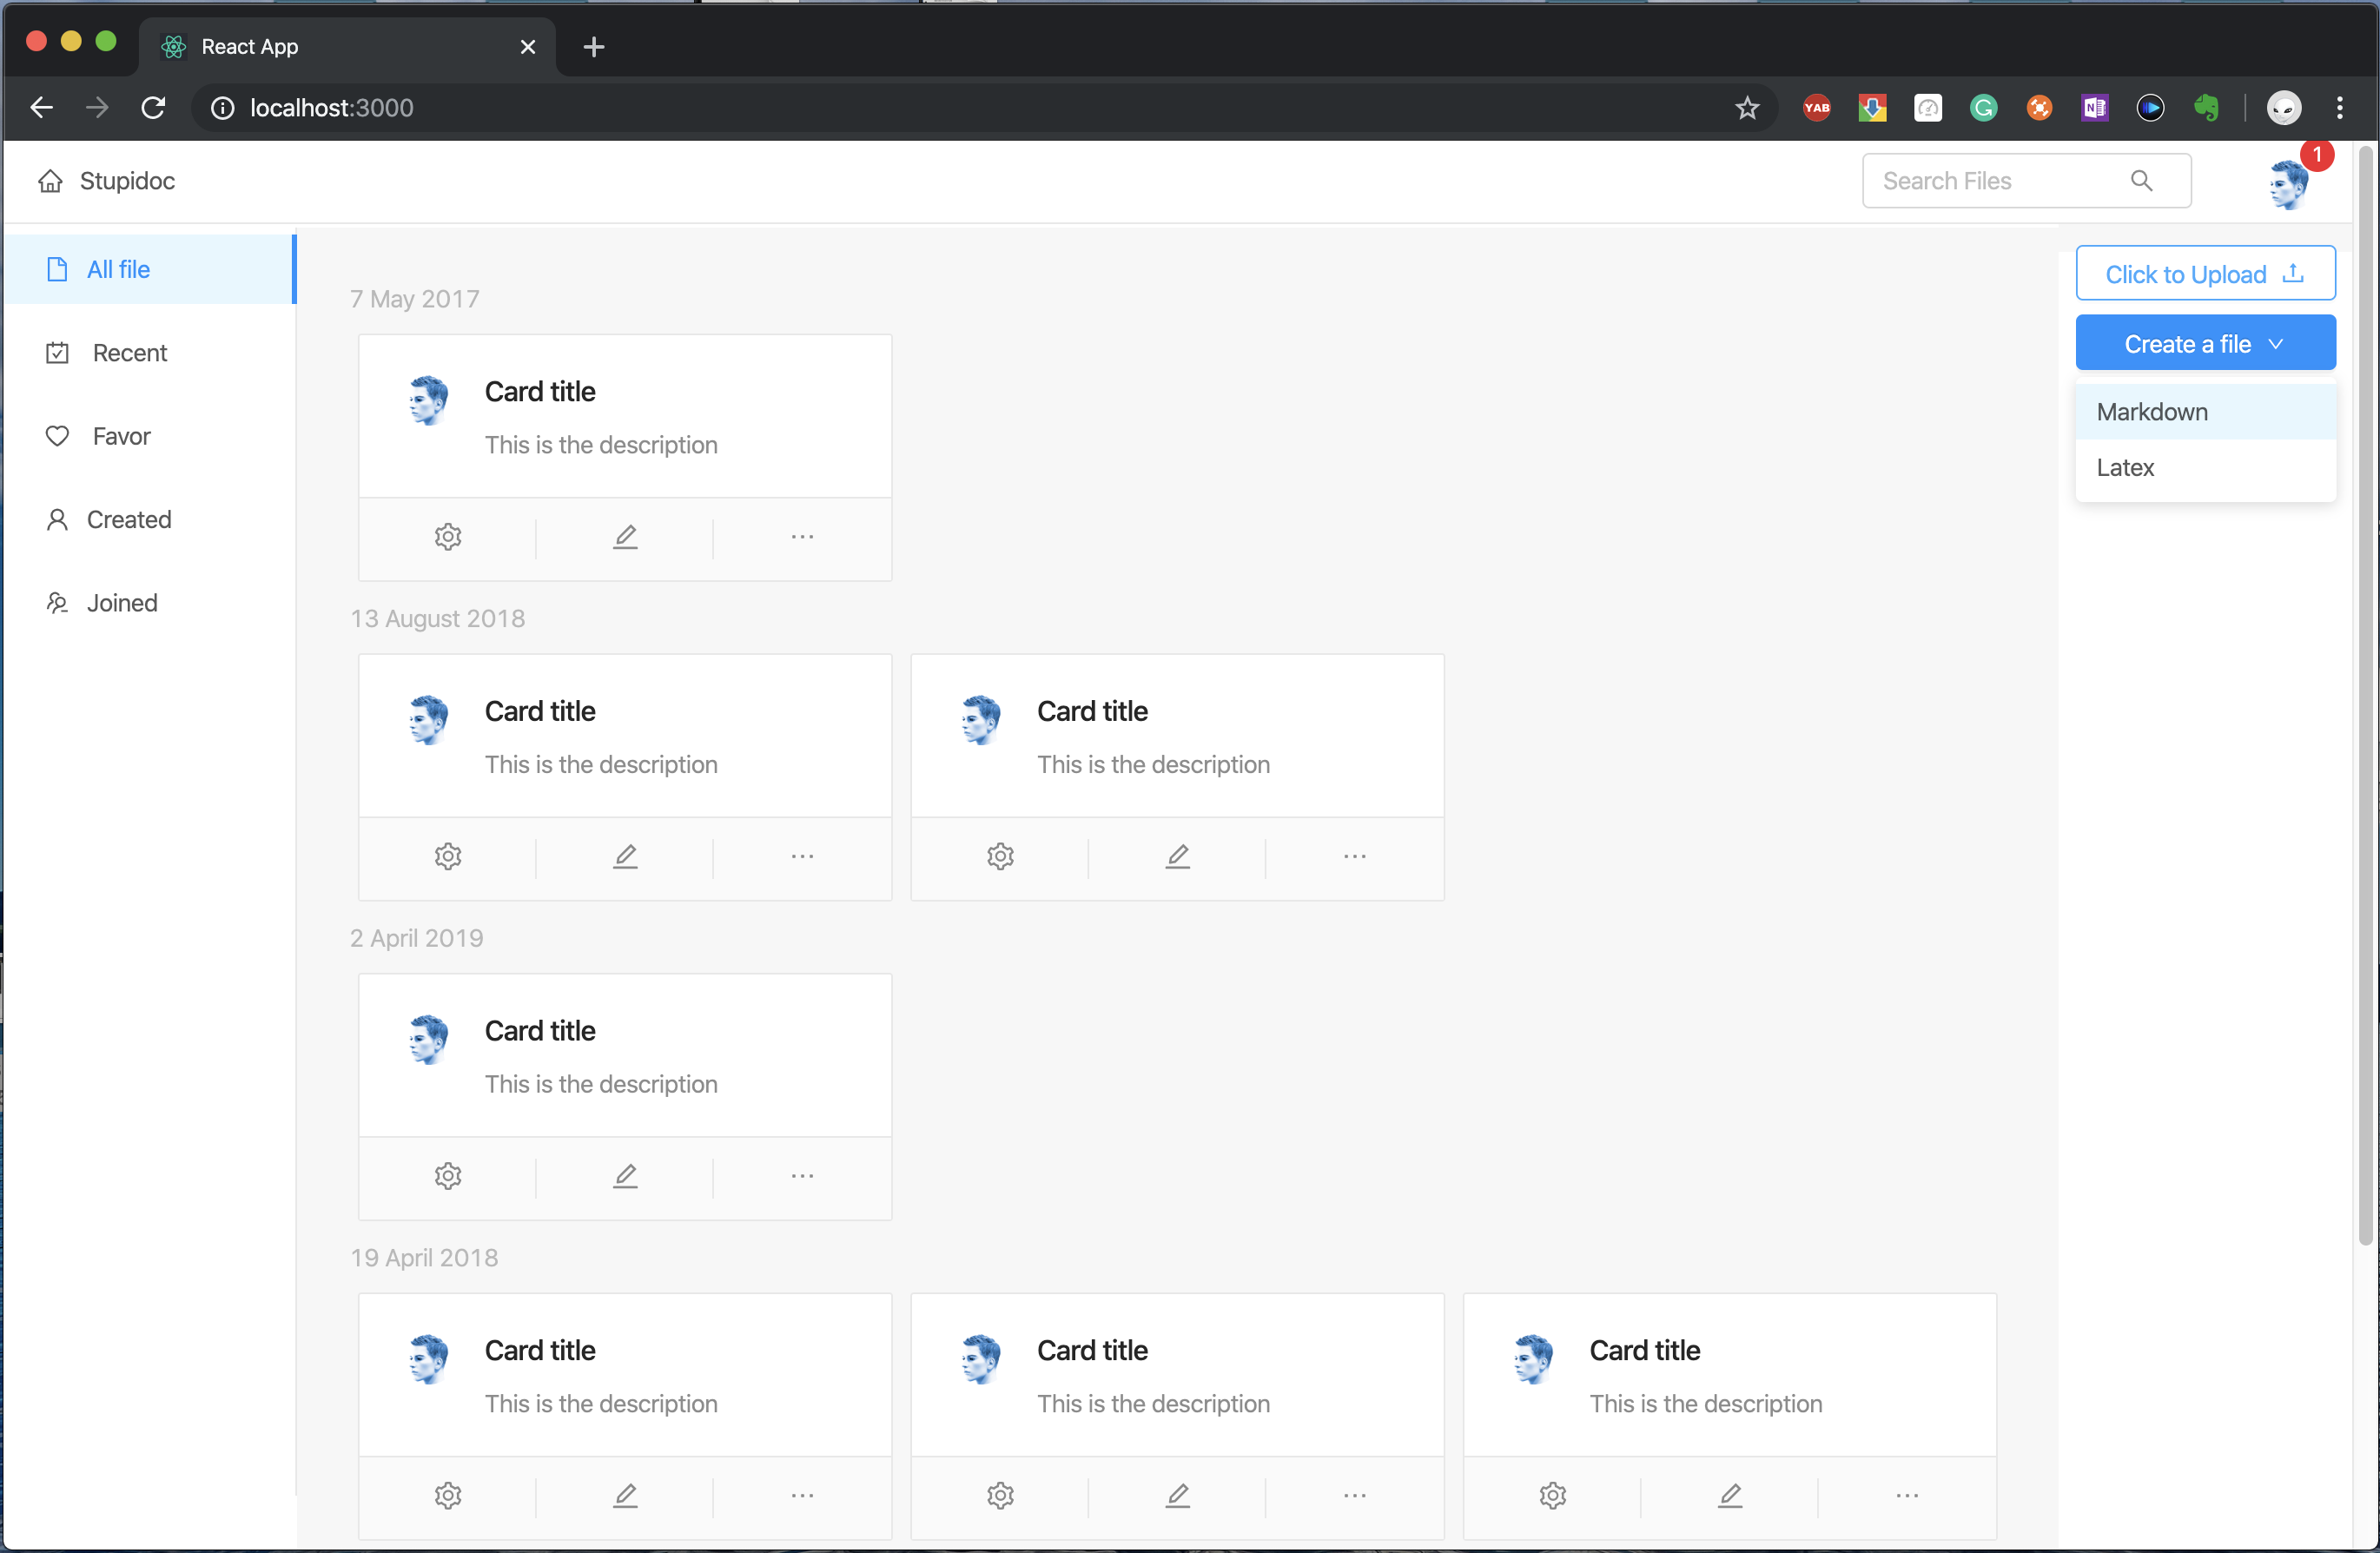
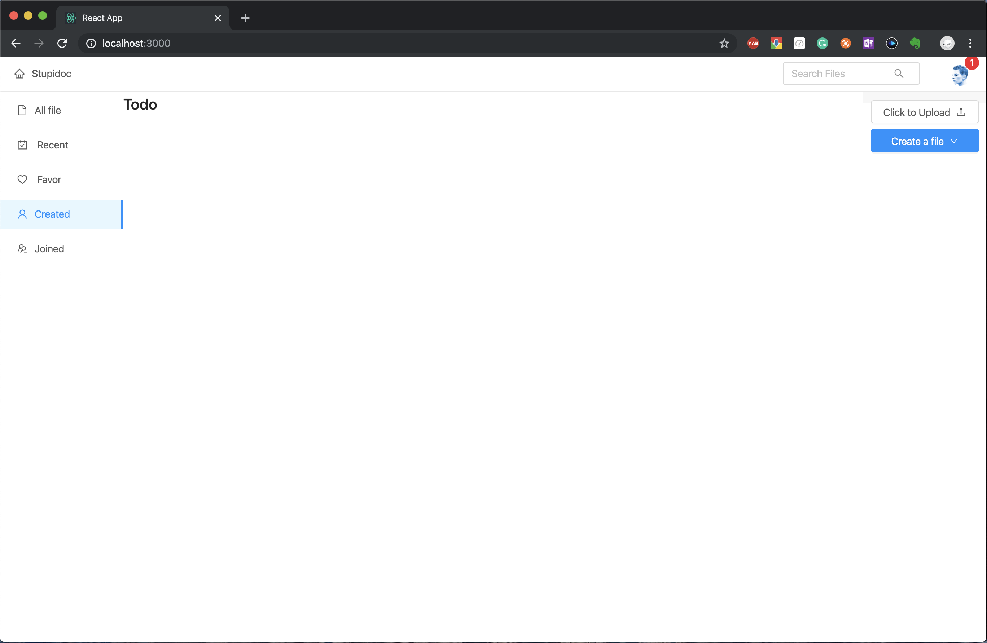
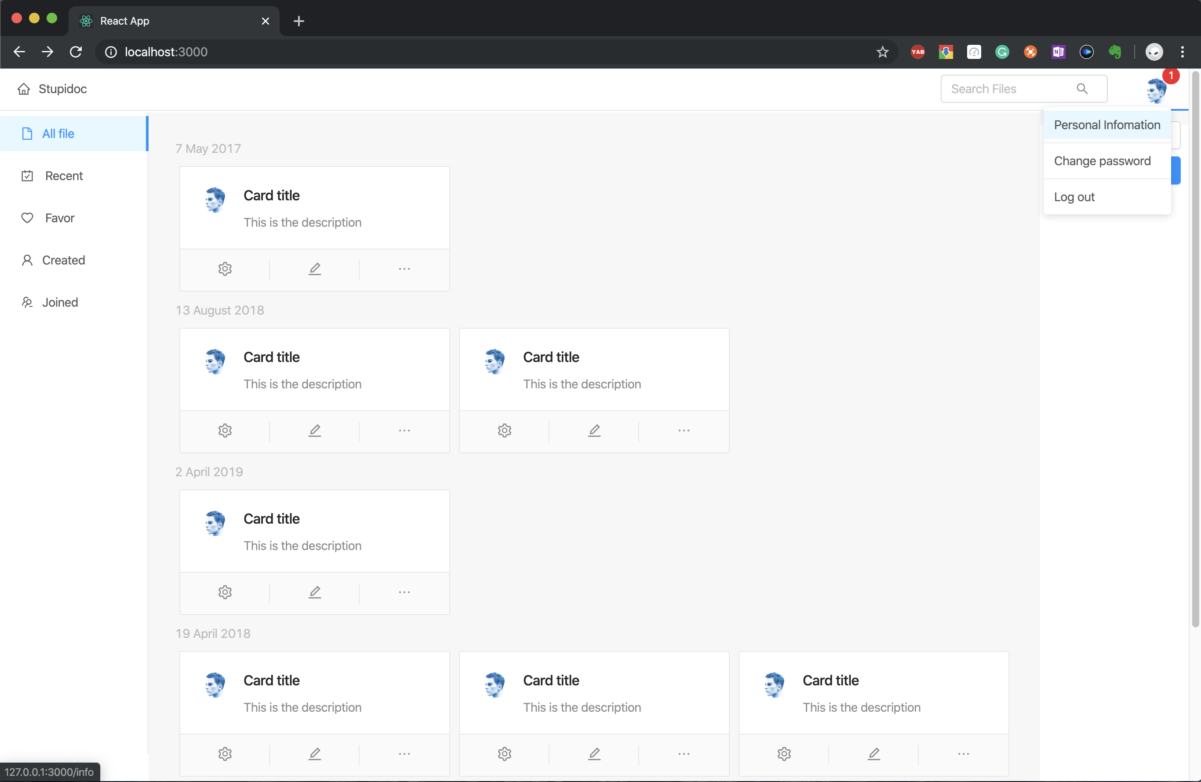
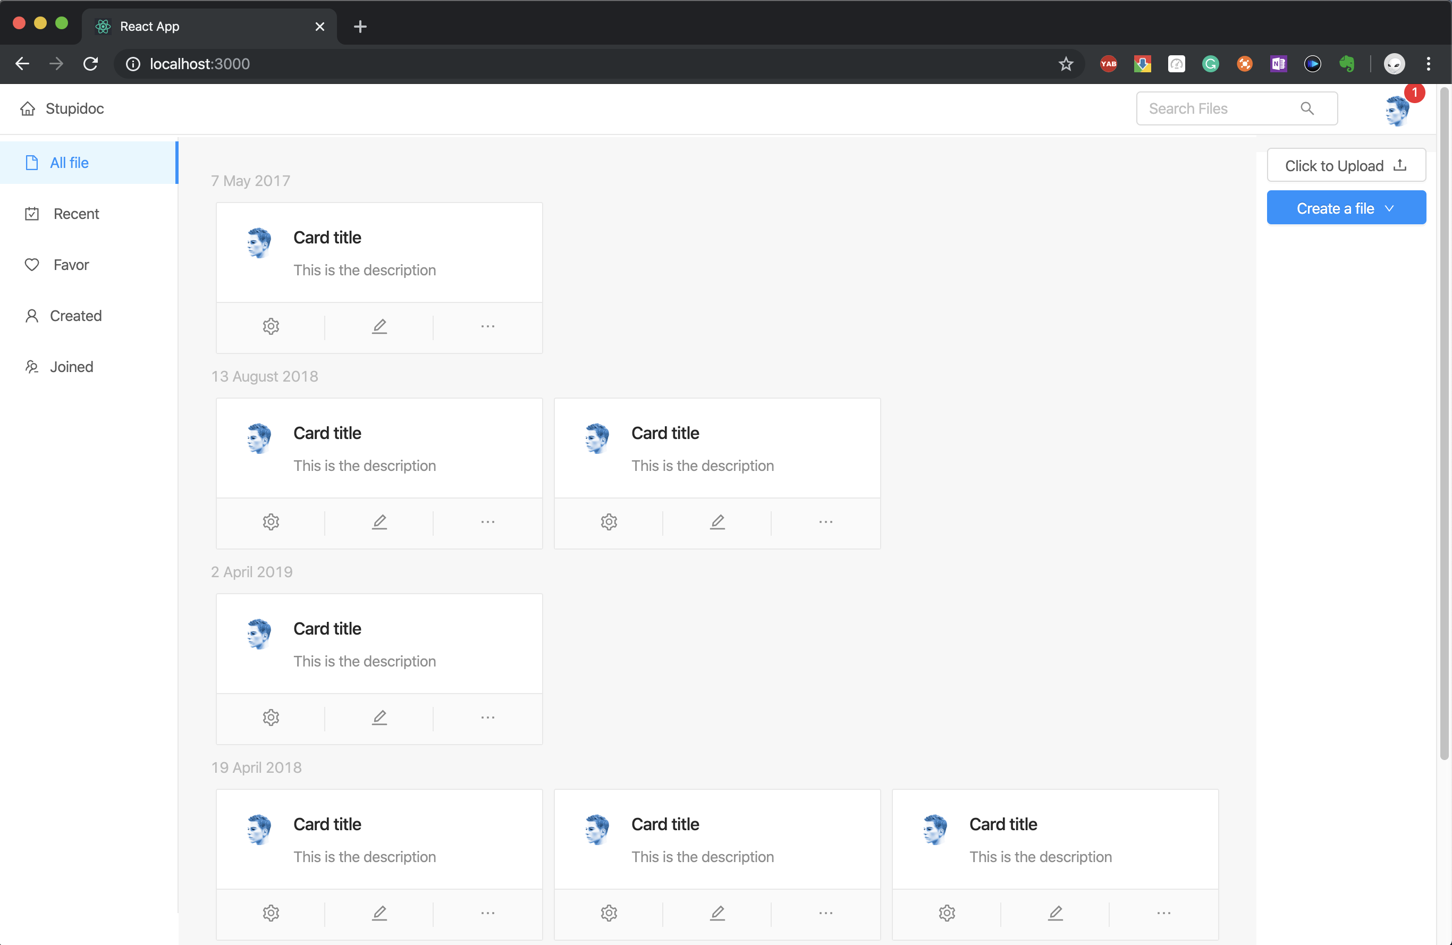
Front-End : Dashboard Page
- ☑️ To user Info page
- ☑️ To Editing page
- ☑️ Display all documents
- 🔘To document info page
- 🔘 Create/Delete a document
- 🔘 Upload a document
- 🔘 Classify doc by authority

Slide 5
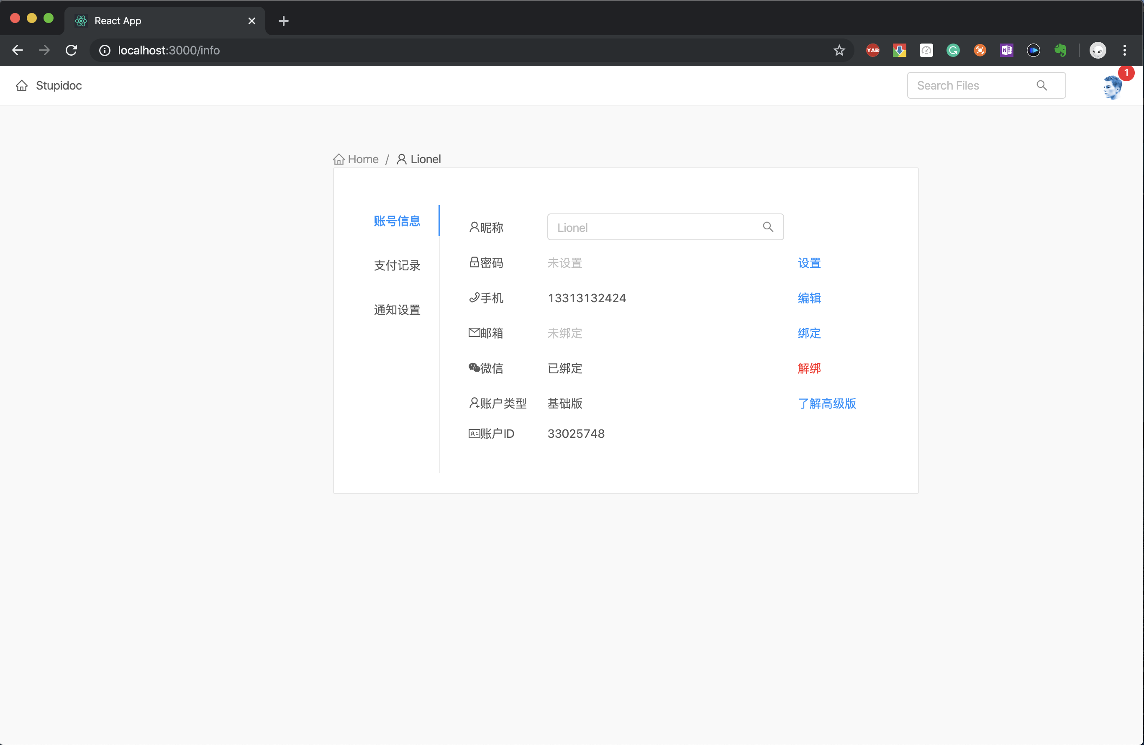
Front-End : Info Page
User Info Page
- ☑️ Change name - ☑️ Change Password
Document Info Page
- 🔘Modify doc Info
- 🔘 Add/ Delete cooperator
- 🔘 Modify authority of
cooperator

Slide 6
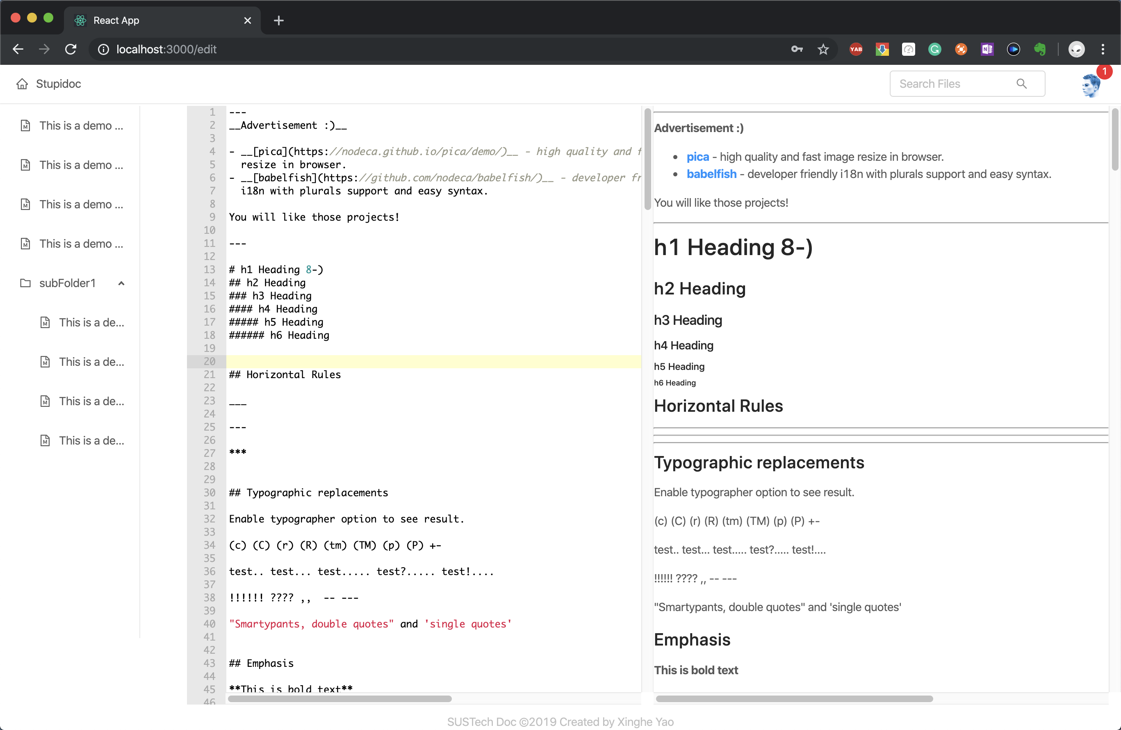
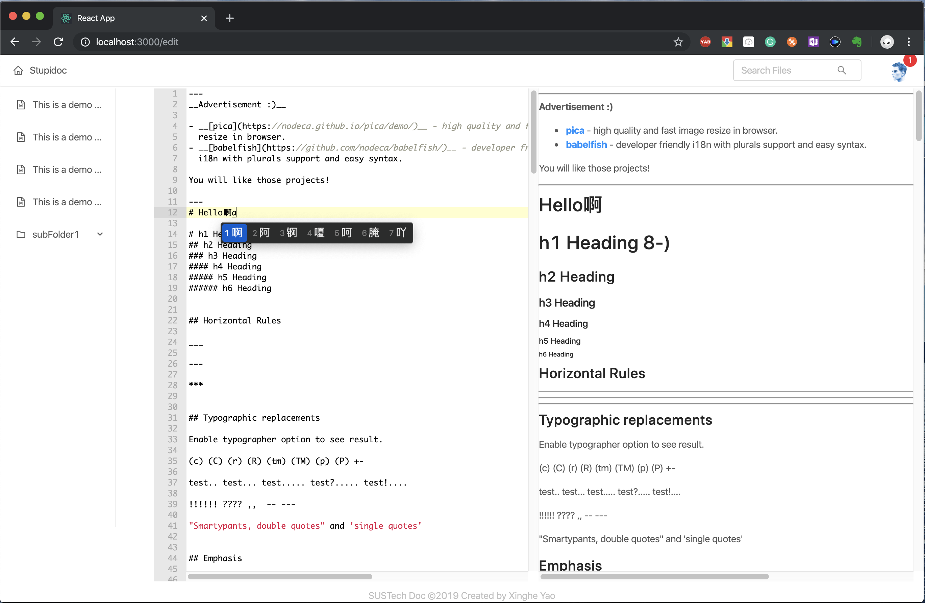
Front-End : Edit Page
☑️ Writing
- 🔘 Upload files
- 🔘 Download files
- 🔘 Compile
- 🔘 Version display
- 🔘 Add version
- 🔘 Version rollback

Slide 7
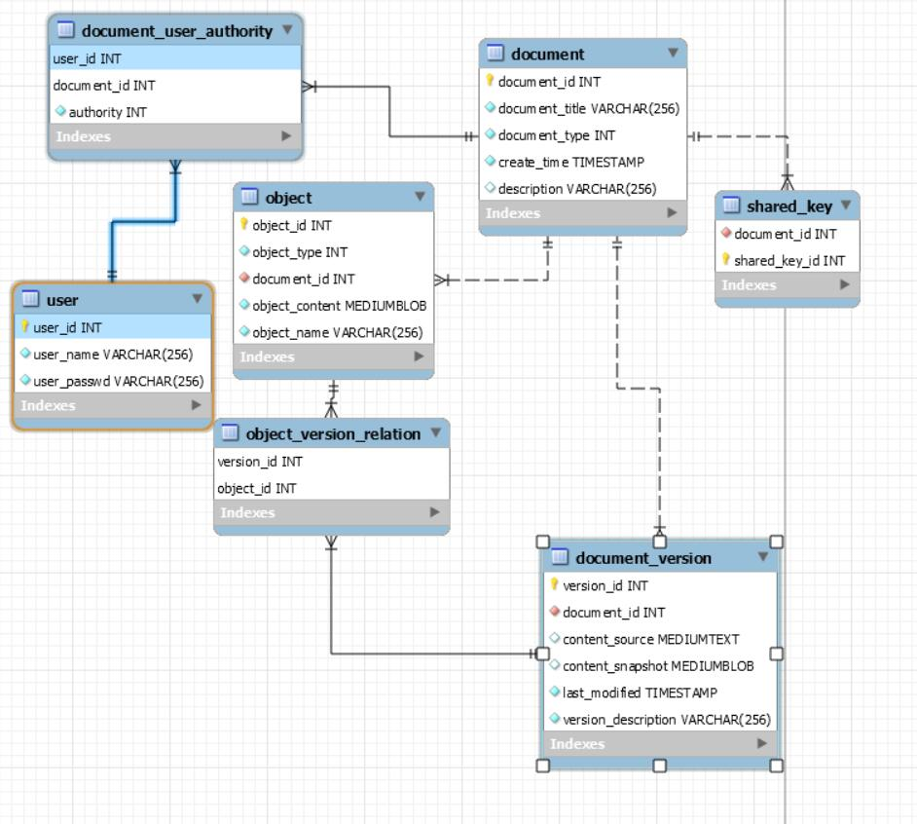
Database
User
User
Doc
Doc
…
Doc
Version1
Version2
…
Version3
Doc object pool

Slide 8
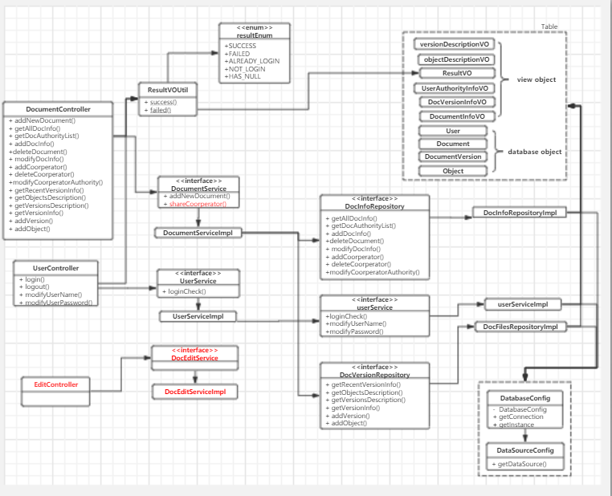
Back-End : UML & Function
- ☑️ Login / Logout
- ☑️ Check already login
- ☑️ Modify user/doc info
- ☑️ Get user doc lists
- ☑️ Create/Delete doc
- ☑️ Delete cooperator
- ☑️ Modify authority
- ☑️ Get editing file & pdf
- ☑️ Get objects/ version list
- ☑️ Version Rollback
- 🔘 Collaborative writing
- 🔘 Shared to other people

Slide 9
Q & A

